Slide 1

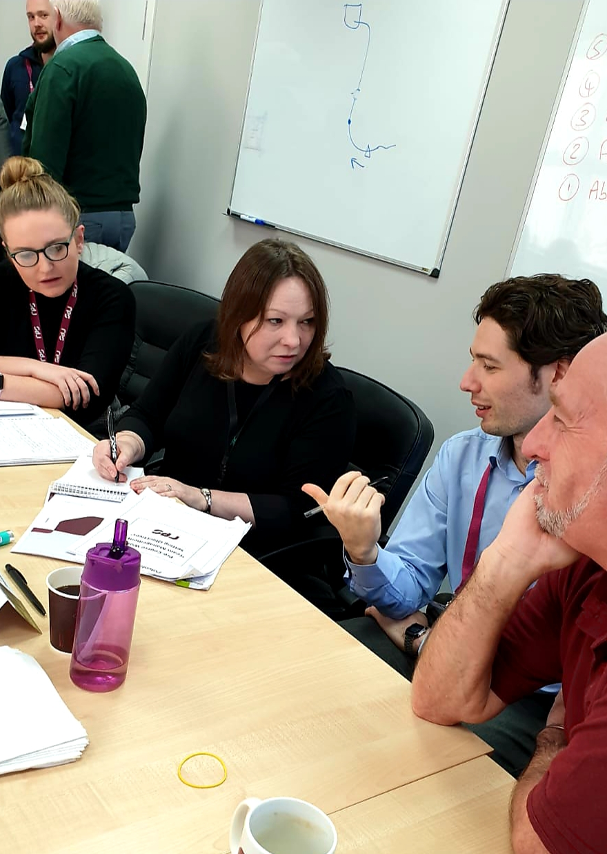
Coaching Skills for Managers… Helping others to reach their potential
Fancy learning how to nurture and develop others by incorporating coaching into your everyday conversations with your team? In our modular Coaching for Managers Programme, we’ll show you how powerful coaching can be and how it can speed up the development of your team.
Here’s a flavour of what we cover:
How to create a culture of coaching within your team
Directive v Non Directive Coaching
Asking the right questions
Structured Coaching - an introduction to the coaching models
“I’m always rubbish at that” - How to challenge assumptions and beliefs
Hearing v Active Listening - The importance of REALLY Listening
“Have you got a minute”? - How to have impromptu 10min coaching conversations
Interested? Get in touch with Mike for a chat to see how we can design a programme that suits you…
www.potentialunearthed.co.uk
mike@potentialunearthed.co.uk

